Slide 1

Medical Advisory Panel (MAP) Meeting
TA MHEH Update
To insert a wordmark:
Add (e.g. via drag and drop) your wordmark file (in RGB) to this slide (in alignment with our brand governance and architecture guidelines)
Change the size of the wordmark according to the height reference (magenta placeholder)
Select the “guides” in the navigation bar and move the wordmark to the right and top line (orange)
  Meiruo LIU | 15th May 2025

Slide 2




2025 TA Key Milestone Overview – Mental Health
Global milestones
mGluR4 NAM – ADHD/BPD
Ph1b PoPP/PoCP FSS (May)
CT-155
Ph3 (US) TLR (Aug)
CT-156
RoFD (Oct)
CT-156
Ph3 (US) FSS (Oct)
GOATi – Impulsivity SuD
Ph1b PoCP FSS (Jan)
NR2B NAM – BD
Ph2 FSS (Oct)
NR2B NAM – MDD Mono
Ph2 TLR (Jul)
NR2B NAM – MDD
EoP2 (Sep)
SSTR4 – CI PSD
Ph1 SRD/MRD FSS (Jan)
NR2B NAM – MDD Adj
Ph2 TLR (May)
NR2B NAM – MDD Adj
RoFD (Jul)
NR2B NAM – MDD Adj
RoFD (Oct)
Iclepertin - CIAS
CONNEX-2/3 TLR (13th Jan)
JAN | FEB | MAR | APR | MAY | JUN | JUL | AUG | SEP | OTC | NOV | DEC
Timeline to be reassessed according to the updated global timeline
Iclepertin - CIAS
CONNEX China TLR (Jan)
NR2B NAM – MDD adj/mono
EoP2 Meeting (Q3)
NR2B NAM – MDD adj/mono
Ph3 CTA Sub (Q4)
Precision Psychiatry in Impulsivity Assets
HAI Sub (11th Feb)
Precision Psychiatry in Impulsivity Assets
HAI Virtual Conference (Apr)
China milestones
Timeline to be reassessed according to the updated global timeline
NR2B NAM – BD
Ph2 Pre-IND Meeting Sub (Jun)
NR2B NAM – BD
Ph2 CTA Sub (Oct)
Phase I
Phase II
Phase III
Confirmatory
Other Activities
1st Submission
1st Launch
PoCP
RoFD
TLR
HAI
Study start/ read-out
Termination
Milestone

Slide 3
Mental Health: Decisions/Advice provided by TA-CEC (Apr 2025 – May 2025)
Topic | Background | TA-CEC Decisions/Advice | Next steps/ Updates
China Integration Strategy into NR2B NAM MDD Ph3 | The global asset team is proposing an US acceleration plan assuming a Go scenario from MDD Ph2 readouts. Two US focused trials will be conducted to support accelerated US launch by 4 months; and two global (RoW) trials will be conducted to support CN/JP NDA with postponed NDA and launch compared with the current plan (3 parallel MRCTs). The China team proposes to participate in the US focus trials by enrolling approximately 40 Chinese patients (10 sites) per trial. This approach aims to ensure simultaneously accelerated NDA submission, with registrational and operational feasibility for China without impacting the global timeline for the US launch. | Endorsed by Mar CEC | Update after MDD Ph2 Adjunctive readout
NR2B NAM TLR Local Communication Plan | Ph2 MDD Adjunctive TLR: China early asset team members and RA representative will be informed with global meeting invitation. Per global guidance, high level information can be shared only to local EoP2 submission team and local MKT/MA core team for ICP. Further distribution will be made at the townhall on July 10th together with Ph2 MDD Monotherapy TLR. External communications only after both trials have read out. | Endorsed in May CEC | Communication per global guidance

Slide 4
Mental Health Portfolio Key Update – Late-Stage Assets
Asset Name (MoA) | Indication | China Approval (base case) | Update | Next Step
Iclepertin (GlyT1) | CIAS | NA | China: China CIAS Review: response submitted to Chinese Journal of Psychiatry on Apr 2nd (Authorship: Prof. Tianmei Si, on behalf of Chinese Society of Psychiatry - Schizophrenia branch) BJ-PERFECT (VR) study (ECR): 6 pts and 206 HCs have been enrolled Checklist program for CIAS screening: Delphi interview process Global: CONNEX Pooled publication: The draft version had been reviewed by Prof. Wang Gang and Prof. Hongyan Zhang with feedback provided. Target journal is Lancet Psychiatry and target submission date is May 2025.
One HP Priority
TA Priority
Notes:
BJ-PERFECT study:
BJ-PERFECT is a performance-based functional ecological test for functional capacity evaluation which was first originally generated from Chinese context. Translate into VR will benefit its clinical application. The primary objective of this study is to examine reliability, validity, the difference between pts with SCZs and HCs of BJ-PERFECT VR.
FES study:
This is a cross-sectional study of Chinese adult patients with first episode of schizophrenia (FES) based on existed data
The primary objective is to explore the relationship pattern between subdomain of cognition and current global functioning in Chinese patients with FES. It’s under protocol review process before termination.

Slide 5
Mental Health Portfolio Key Update – Late-Stage Assets
Asset Name (MoA) | Indication | China Approval (base case) | Update | Next Step
NR2B NAM | MDD adjunct / mono | Nov 2029 | China: China Integration Strategy into NR2B NAM MDD Ph3 was updated (Decisions/Advice provided by TA-CEC) MDD adjunctive Ph2 TLR Local Communication Plan was updated (Decisions/Advice provided by TA-CEC) Prof Gang Wang from Beijing An’Ding Hospital was visited on Mar 24th to update on CONNEX results and he accepted the invitation as the China Leading PI for NR2B NAM Ph3 in MDD. 1st wave internal training for MSLs and commercial team was completed on May 12th. Global: NR2B NAM Global Scientific AB was held online on Mar 25th. Prof. Gang Wang was not able to join the meeting due to conflicts and his insights were provided prior to the AB meeting by the local team. The next Global scientific AB is planned on May 23rd after MDD adjunctive ph2 TLR. | Evidence gap analysis will be performed within limited scope of local members. China integration strategy will be aligned with global team after ph2 readouts.
 | BD | 2032 | China: Prof Gang Wang accepted the invitation as the China Leading PI for NR2B NAM Ph2 in BD. Global: Ph2 BD is planned to be accelerated from Q1 2026 to Q4 2025. And FDA pre-IND is planned for Q3 2025. | Update China BD preparation timeline after Global MDD ph2 readouts
One HP Priority
TA Priority

Slide 6
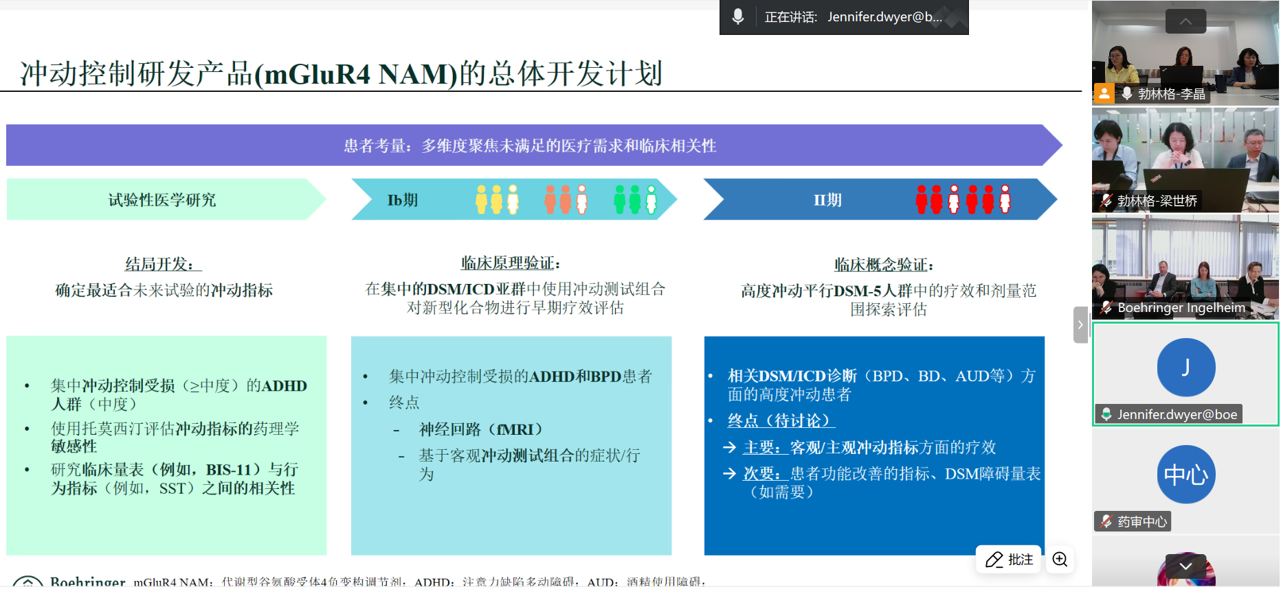
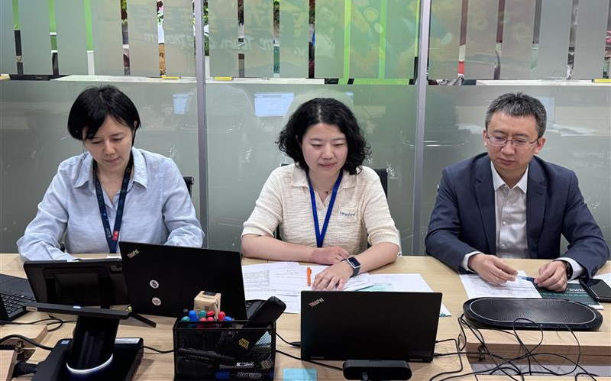
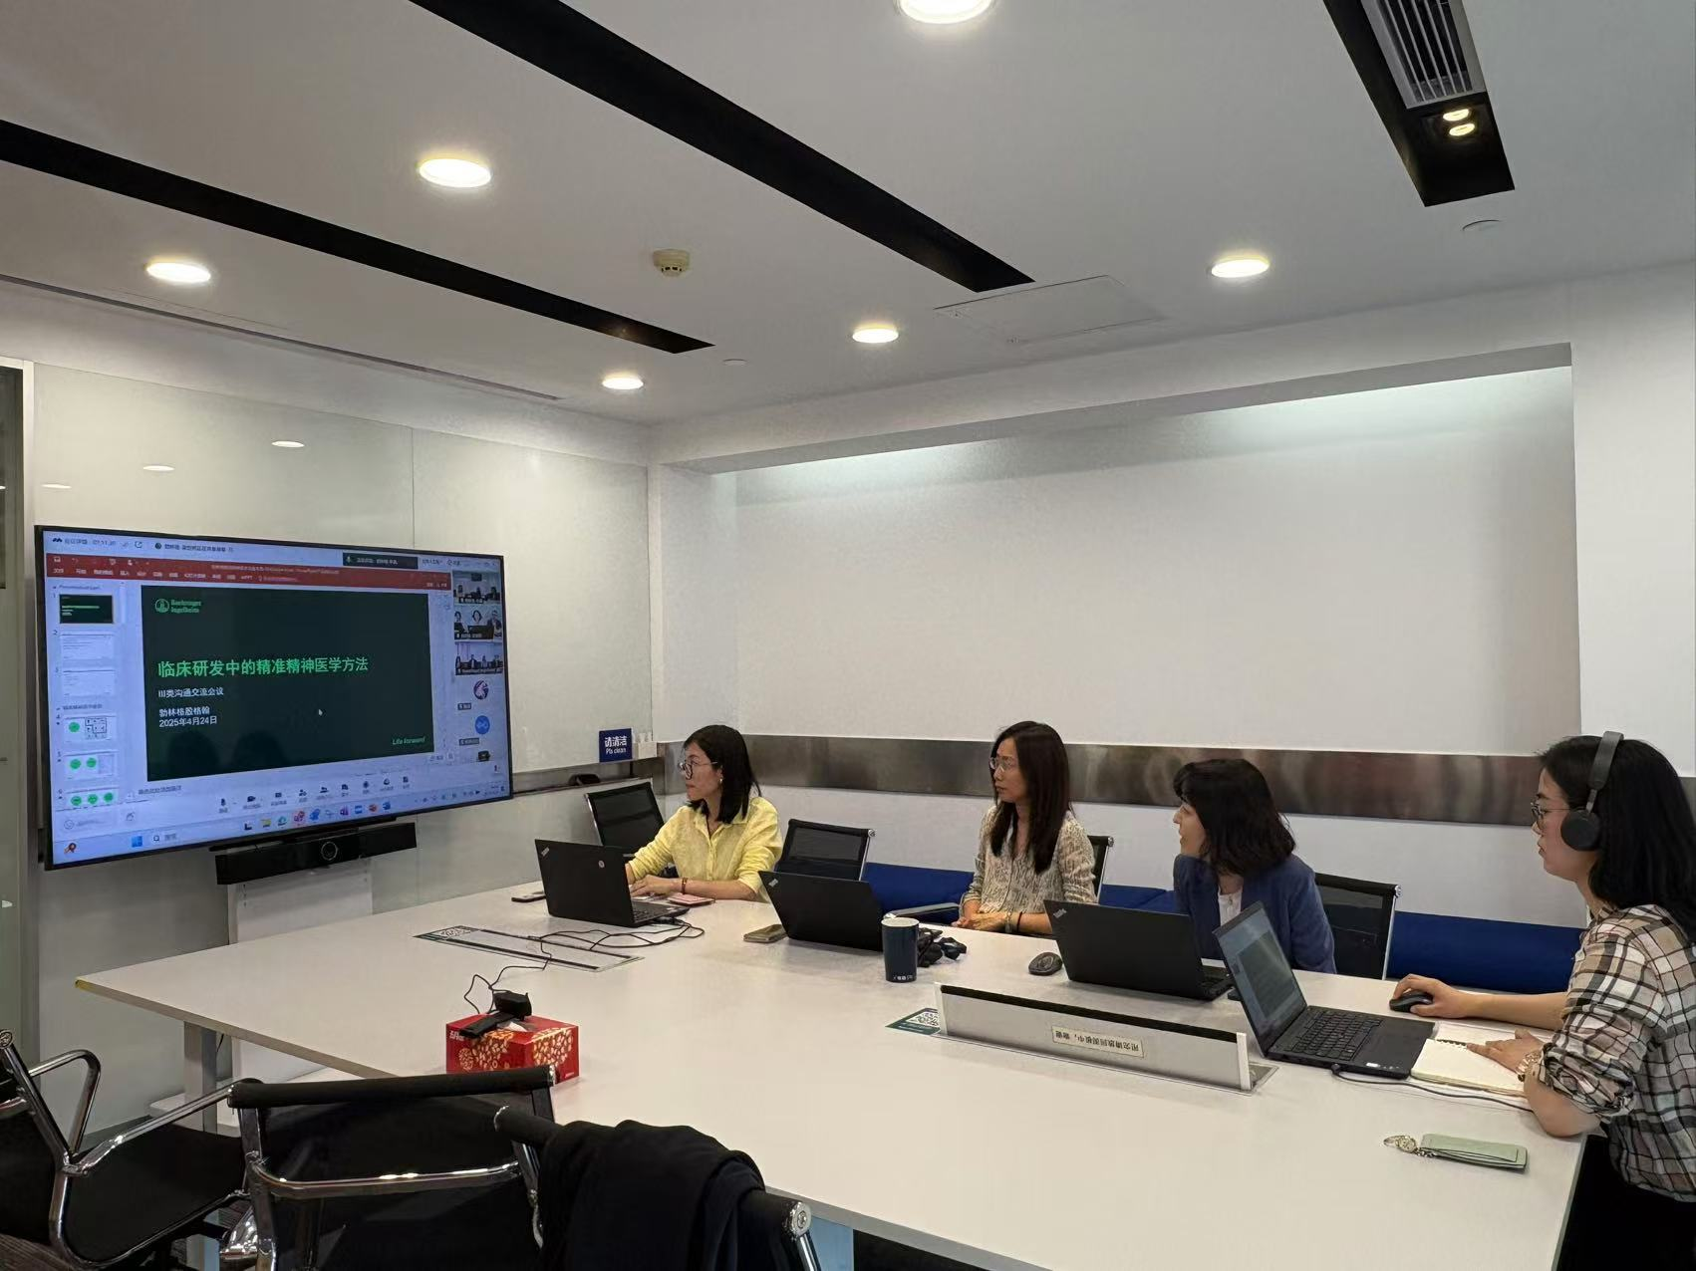
Mental Health: Other Update
The HA interaction on Precision Psychiatry was successfully completed on 24 April 2025
On April 24th, 2025, a scientific exchange meeting with CDE on Precision Psychiatry was successfully held, inviting Prof. Zhen WANG from Shanghai Mental Health Center as an external expert.
CDE highly appreciated Boehringer Ingelheim's commitment to innovative drug development in the field of Mental Health, especially for tackling psychiatric disorders and symptoms that are very difficult to overcome and have a high unmet need.
CDE supported the precision psychiatry strategy, suggested including China in the clinical development as early as possible, and gave constructive feedback on the development plan.

Slide 7
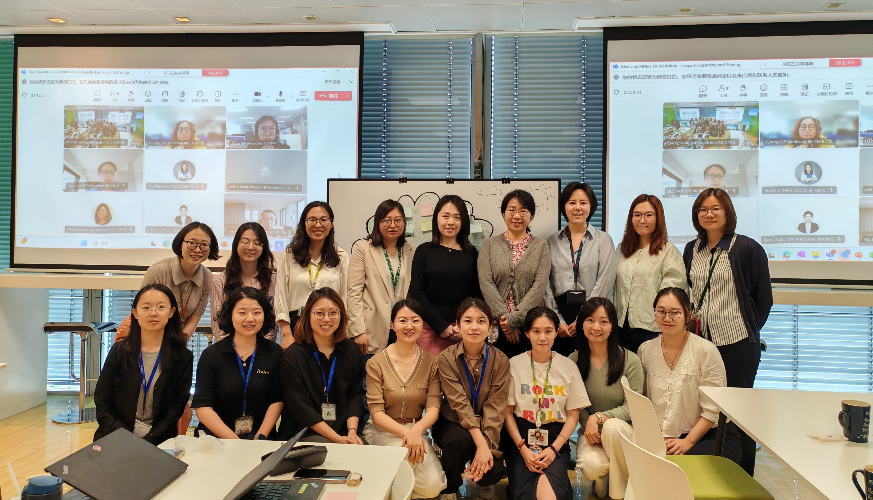







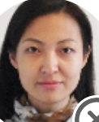

























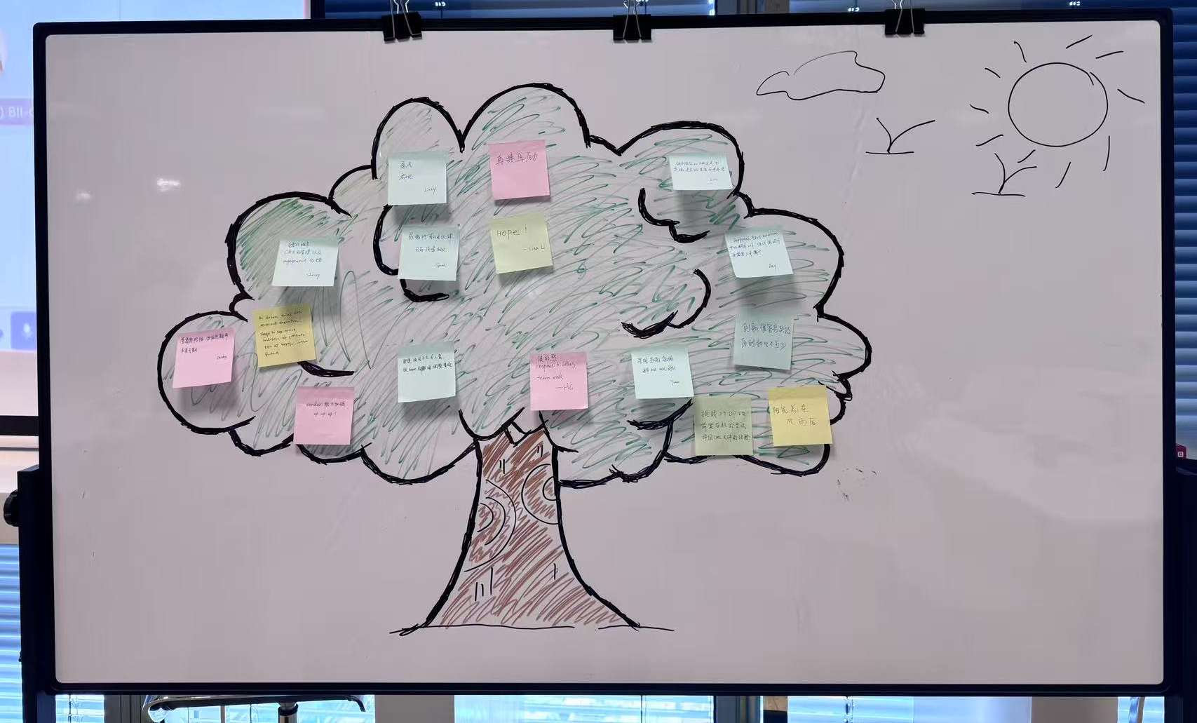












TA Workshop – Iclepertin Learning and Good Practice Sharing
Iclepertin Medicine Family
Iclepertin Learning and Good Practice Sharing
Date: May 14th, 2025
Time: 9:30 – 11:30
Venue: 30F, Canteen
Objectives：
Closure and Gratitude for Iclepertin
  To summarize the key learnings
  To share insights and good practice
  To acknowledge the team contributions
2. Future Value for NR2B NAM
  To leverage local good practices from Iclepertin as key enablers to enhance and drive future work in upcoming mental health pipelines.

Slide 8
2025 TA Key Milestone Overview – Eye Health
Global milestones
Nintedanib IVT XR Termination (Apr HPSC)
PAFR Antago - GA
Ph2 FSS (Jan)
Anti-C3 – GA
PMDA informal HAI
PKKi - DME
Ph2b FSS (May)
Anti-C3 - GA
Ph2 FSS (Jan)
FZD4/LRP5 - DME
Ph1/2 FSS (Jun)
Delayed to Mar/Apr 2026 due to animal study
JAN | FEB | MAR | APR | MAY | JUN | JUL | AUG | SEP | OTC | NOV | DEC
GA ECR FPI
(May as best case)
Update
DR/DME
CN AB Meeting (Jul)
PKKi – DME Ph2 IM :
Local eAT propose:
Jan 2026 ( before 1st SIV)
PKKi - DME
Ph2 CTA Sub (Mar)
China milestones
PKKi – DME Ph2 1st SIV
Local eAT propose:
Jan/Feb 2026 (before Spring Festival)
Anti-C3 – GA
CDE Type 3 HAI: under evaluation
Phase I
Phase II
Phase III
Confirmatory
Other Activities
1st Submission
1st Launch
PoCP
RoFD
TLR
HAI
Study start/ read-out
Termination
Milestone

Slide 9
Eye Health: Decisions/Advice provided by TA-CEC (Apr 2025 – May 2025)
Topic | Background | TA-CEC Decisions/Advice | Next steps/ Updates
GA Evidence Gap Analysis | With timeline delayed by 4-5 months due to GA ECR contract process, local evidence team proposes: Accelerate enrollment and perform early IA with 6 months follow-up from less than 50 patients (the pre-defined sample size for IA) to catch up with the ph3 decision point in July 2026 for Anti-C3. The team is evaluating the feasibility and risk to conduct informal HAI with CDE after positive feedback from PMDA informal/non-binding consultation which allows JP integration into Anti-C3 Ph3 without early data. Search for additional evidence or insights on GA beyond the GA ECR database. | Endorsed in May CEC | Close engagement with sites Evaluate HAI proposal with local and global teams

Slide 10
Eye Health Portfolio Key Update – Late-Stage and Early-Stage Assets
Asset Name (MoA) | Indication | China Approval (base case) | Update | Next Step
PKKi | DME | Feb 2033 | CTA: China CTA was submitted on Mar 31st and was accepted by CDE on Apr 8th. The team received two HA questions on May 9th about allocated Chinese sample size in the proposed ph2 and whether Chinese patients have been enrolled in ph1. Response will be submitted by May 16th. CTA approval is expected in Jul 2025 SSV: IQVIA & BI teams jointly visited leading PI Prof. Xun Xu on Apr 22nd, and Prof. Xu shared insights on the proposed site list and potential challenge on EC review due to placebo control. | Prepare for other potential CDE query Follow up IQVIA SSV update Invite selected sites PI to attend NAB
Nintedanib IVT | nAMD | NA | Terminated in Apr HPSC due to animal toxicity study not supporting ph1.
One HP Priority
TA Priority

Slide 11
Eye Health: Other Update
GA ECR (in collaboration with Prof. Youxin CHEN from Peking Union Hospital):
  Contract signed on May 13th.
  FPI is expected in May/Jun.
National AB on DR/DME (July 12th, Saturday, Shanghai):
  Global Eye Health pipeline will be introduced, clinical development of PKKi and Anti-Sema 3A, and DR/DME in China will be discussed.
  KEEs invitation is ongoing.

